Slide 1


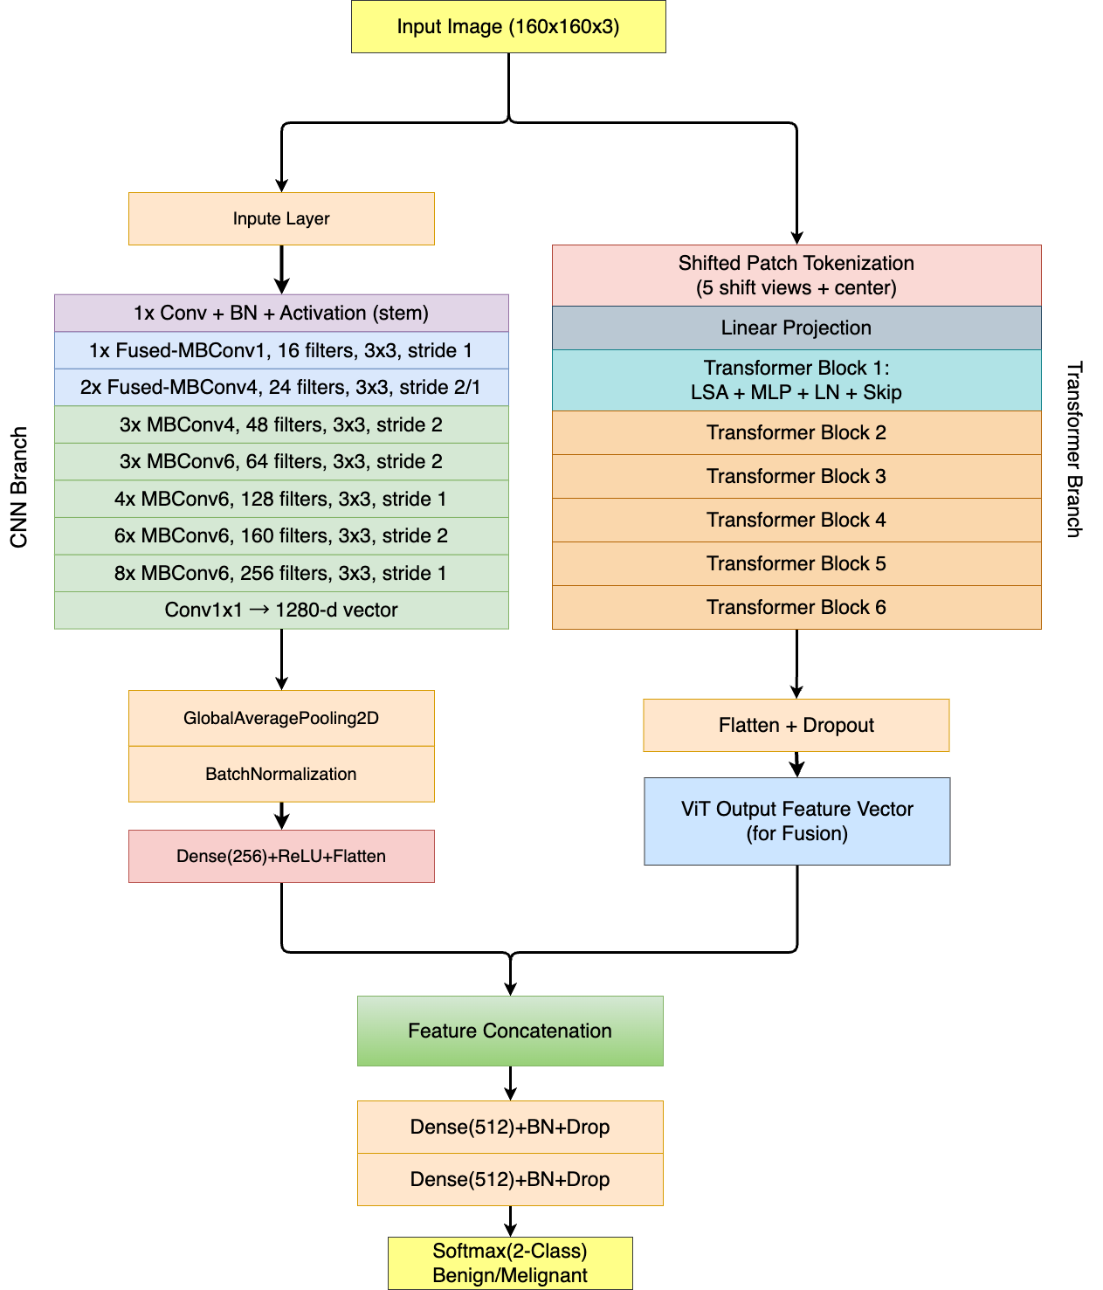
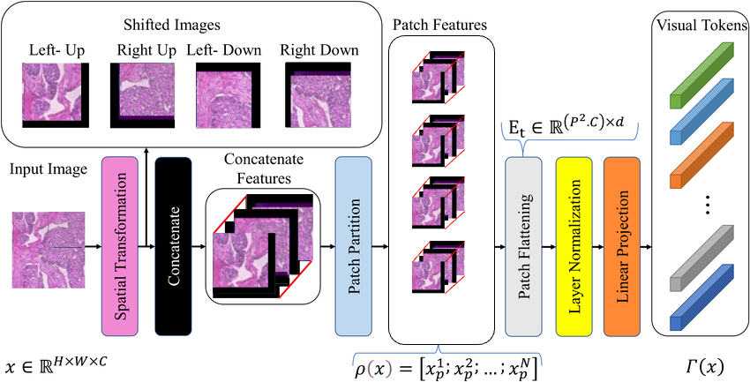
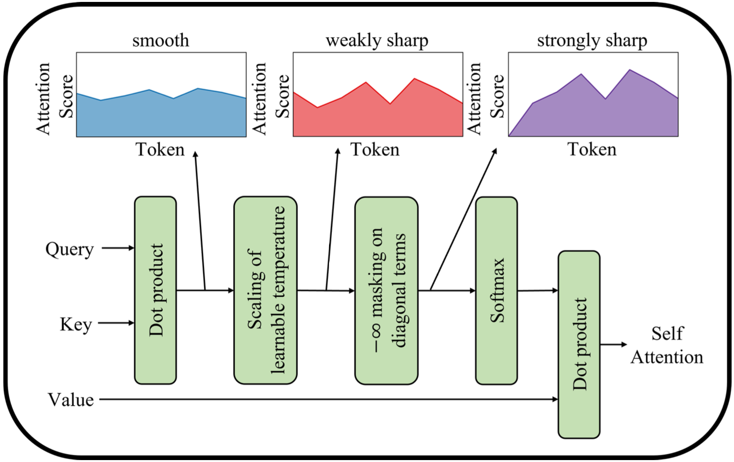
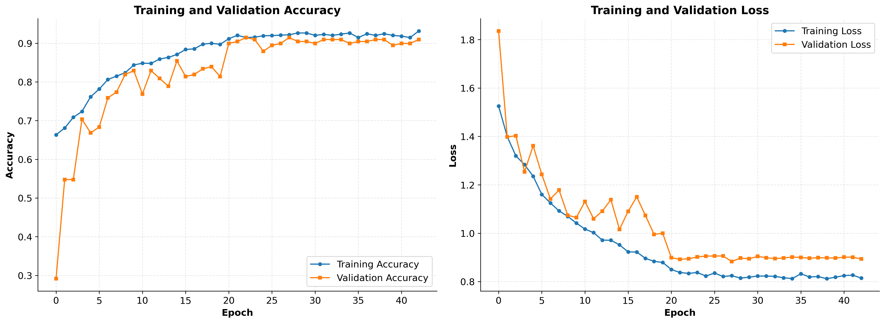
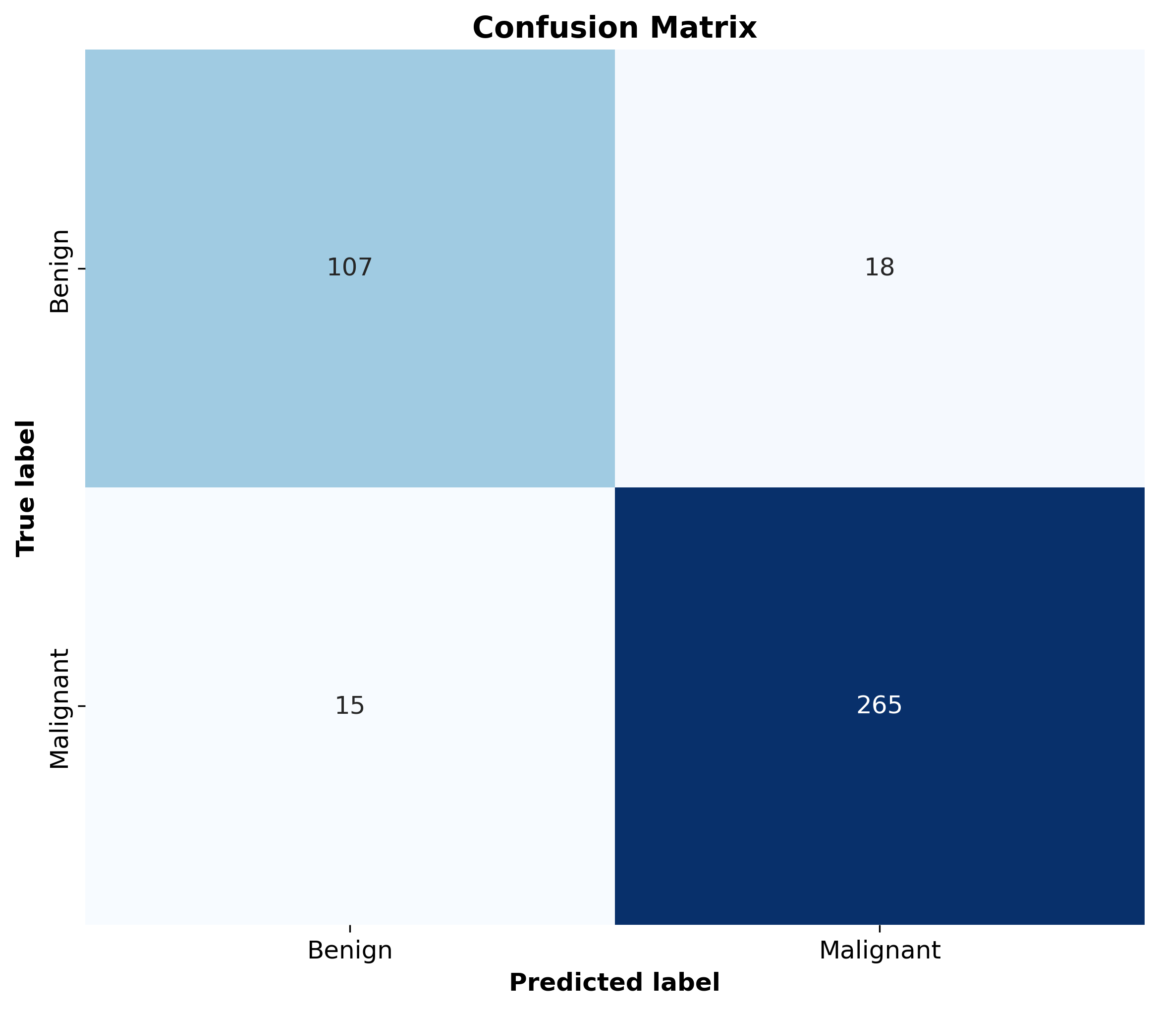
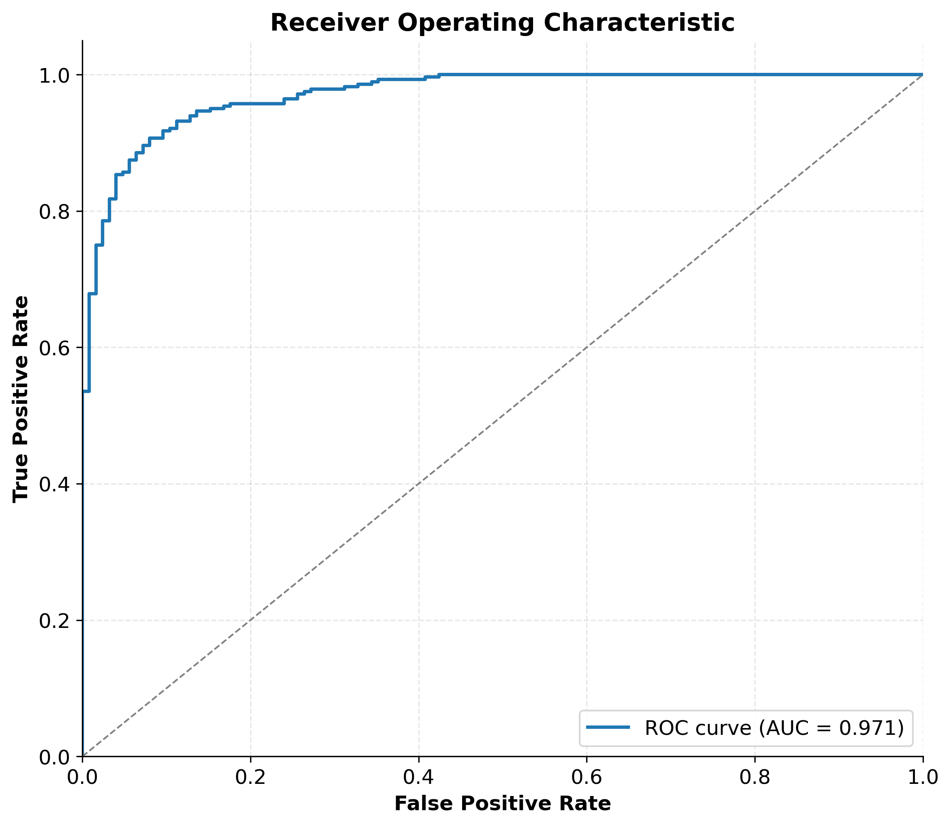
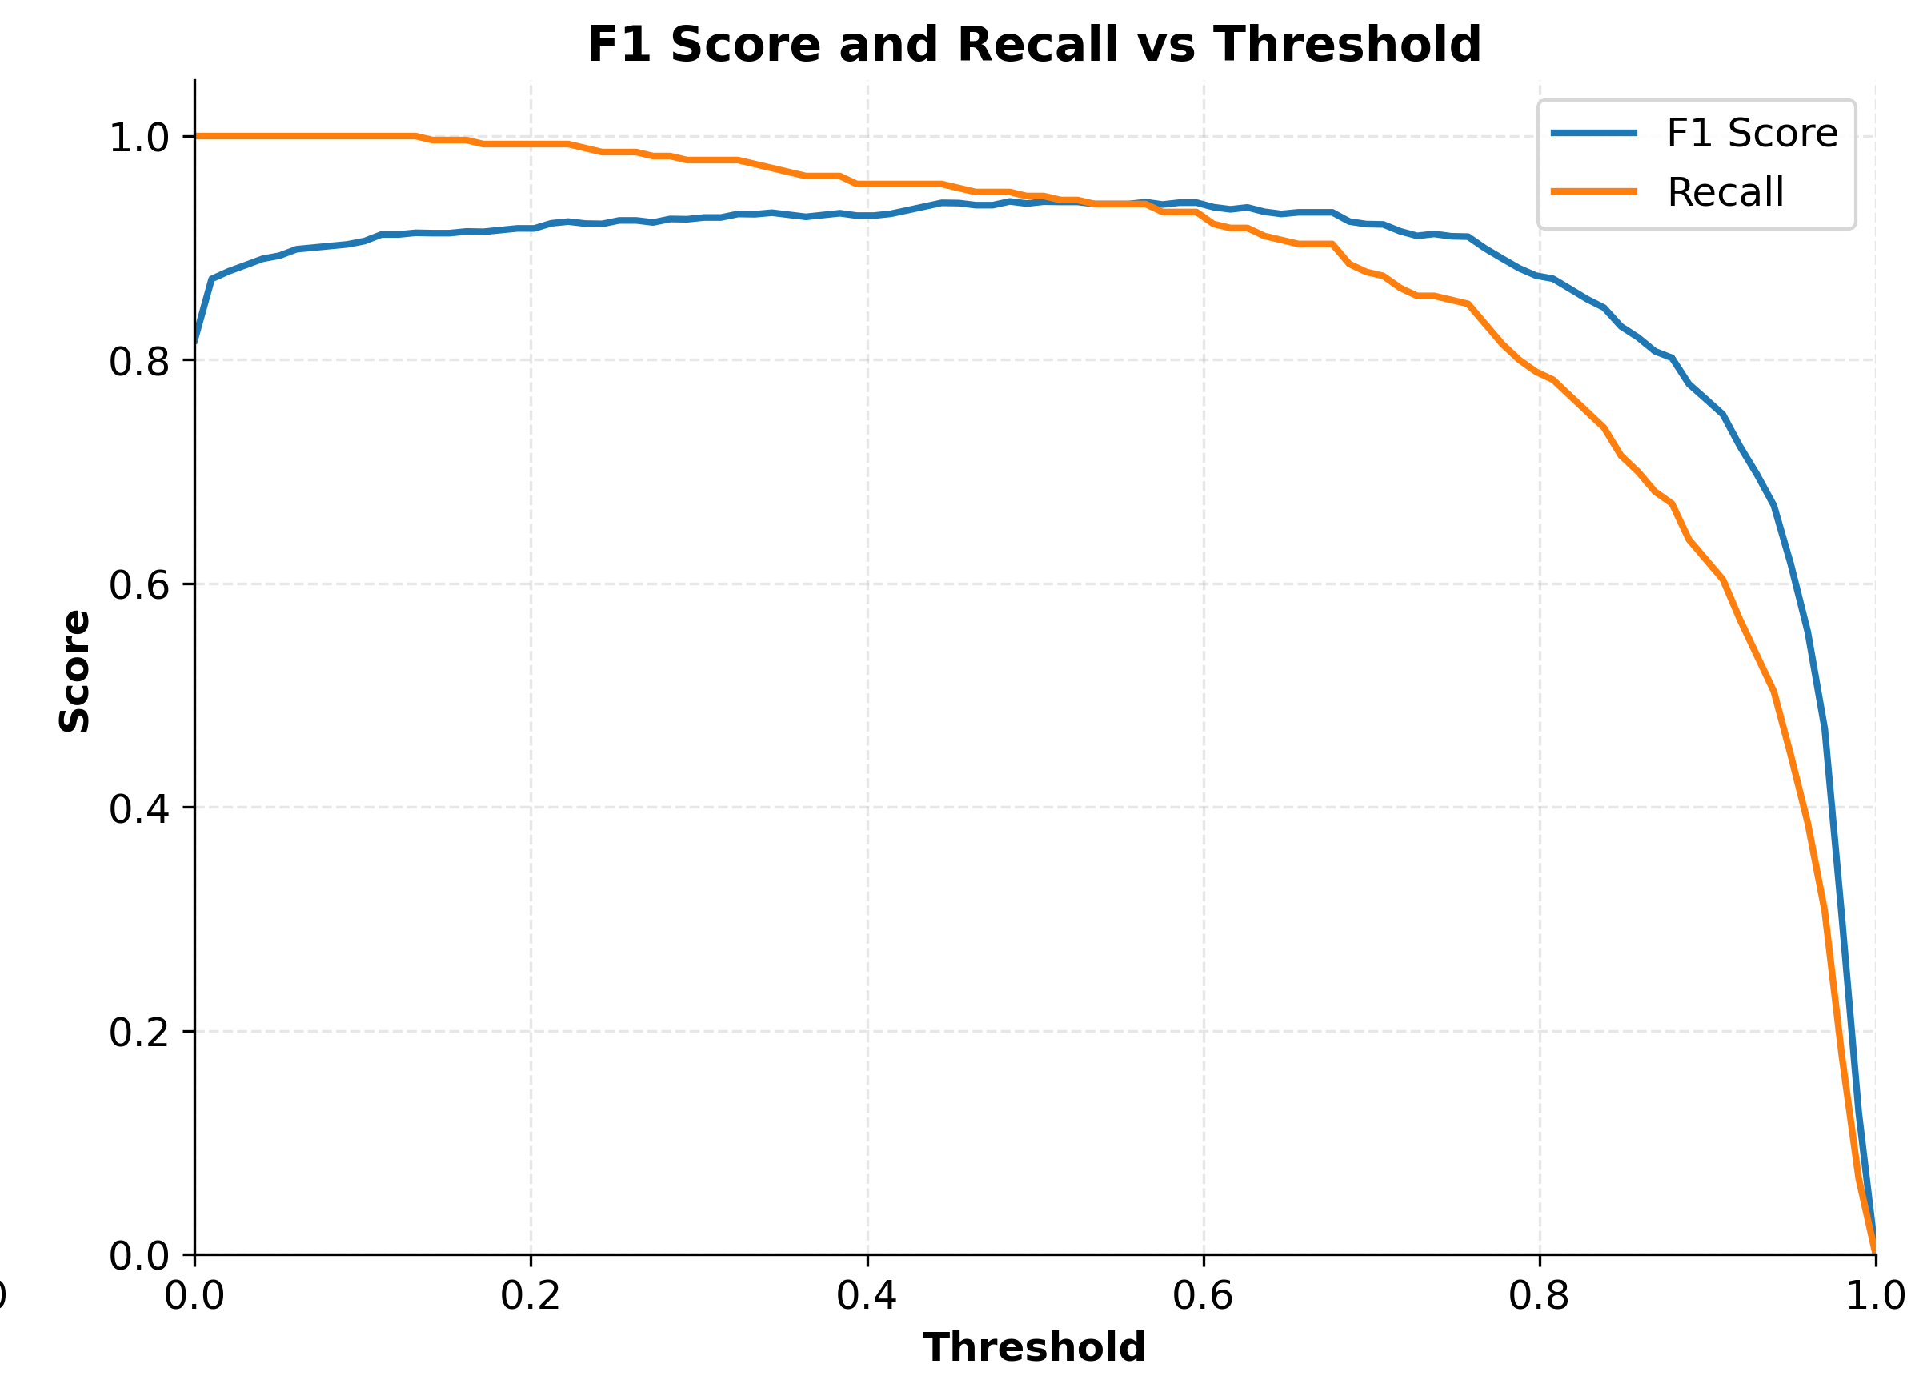
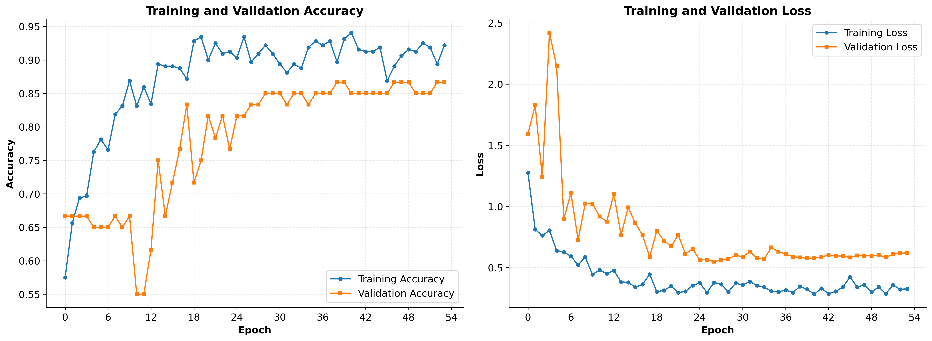

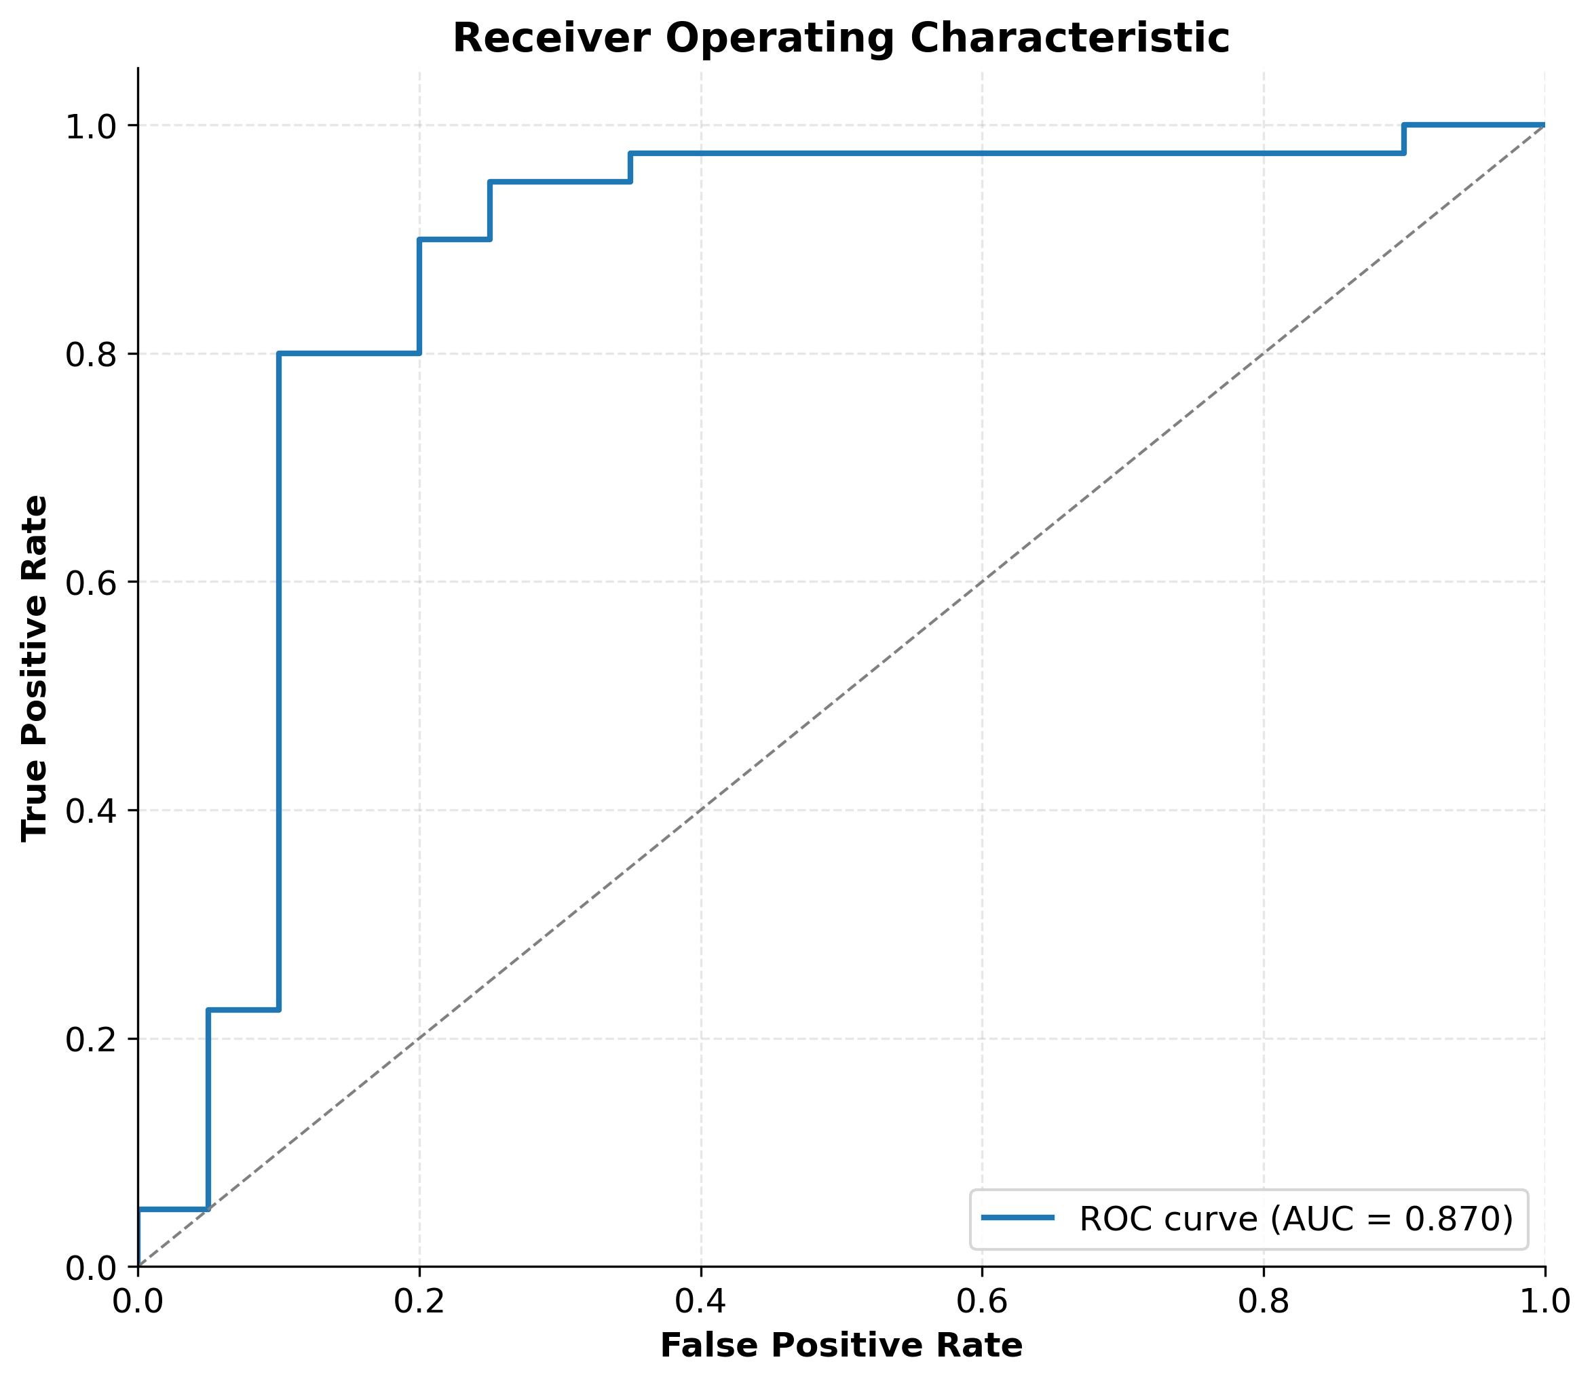
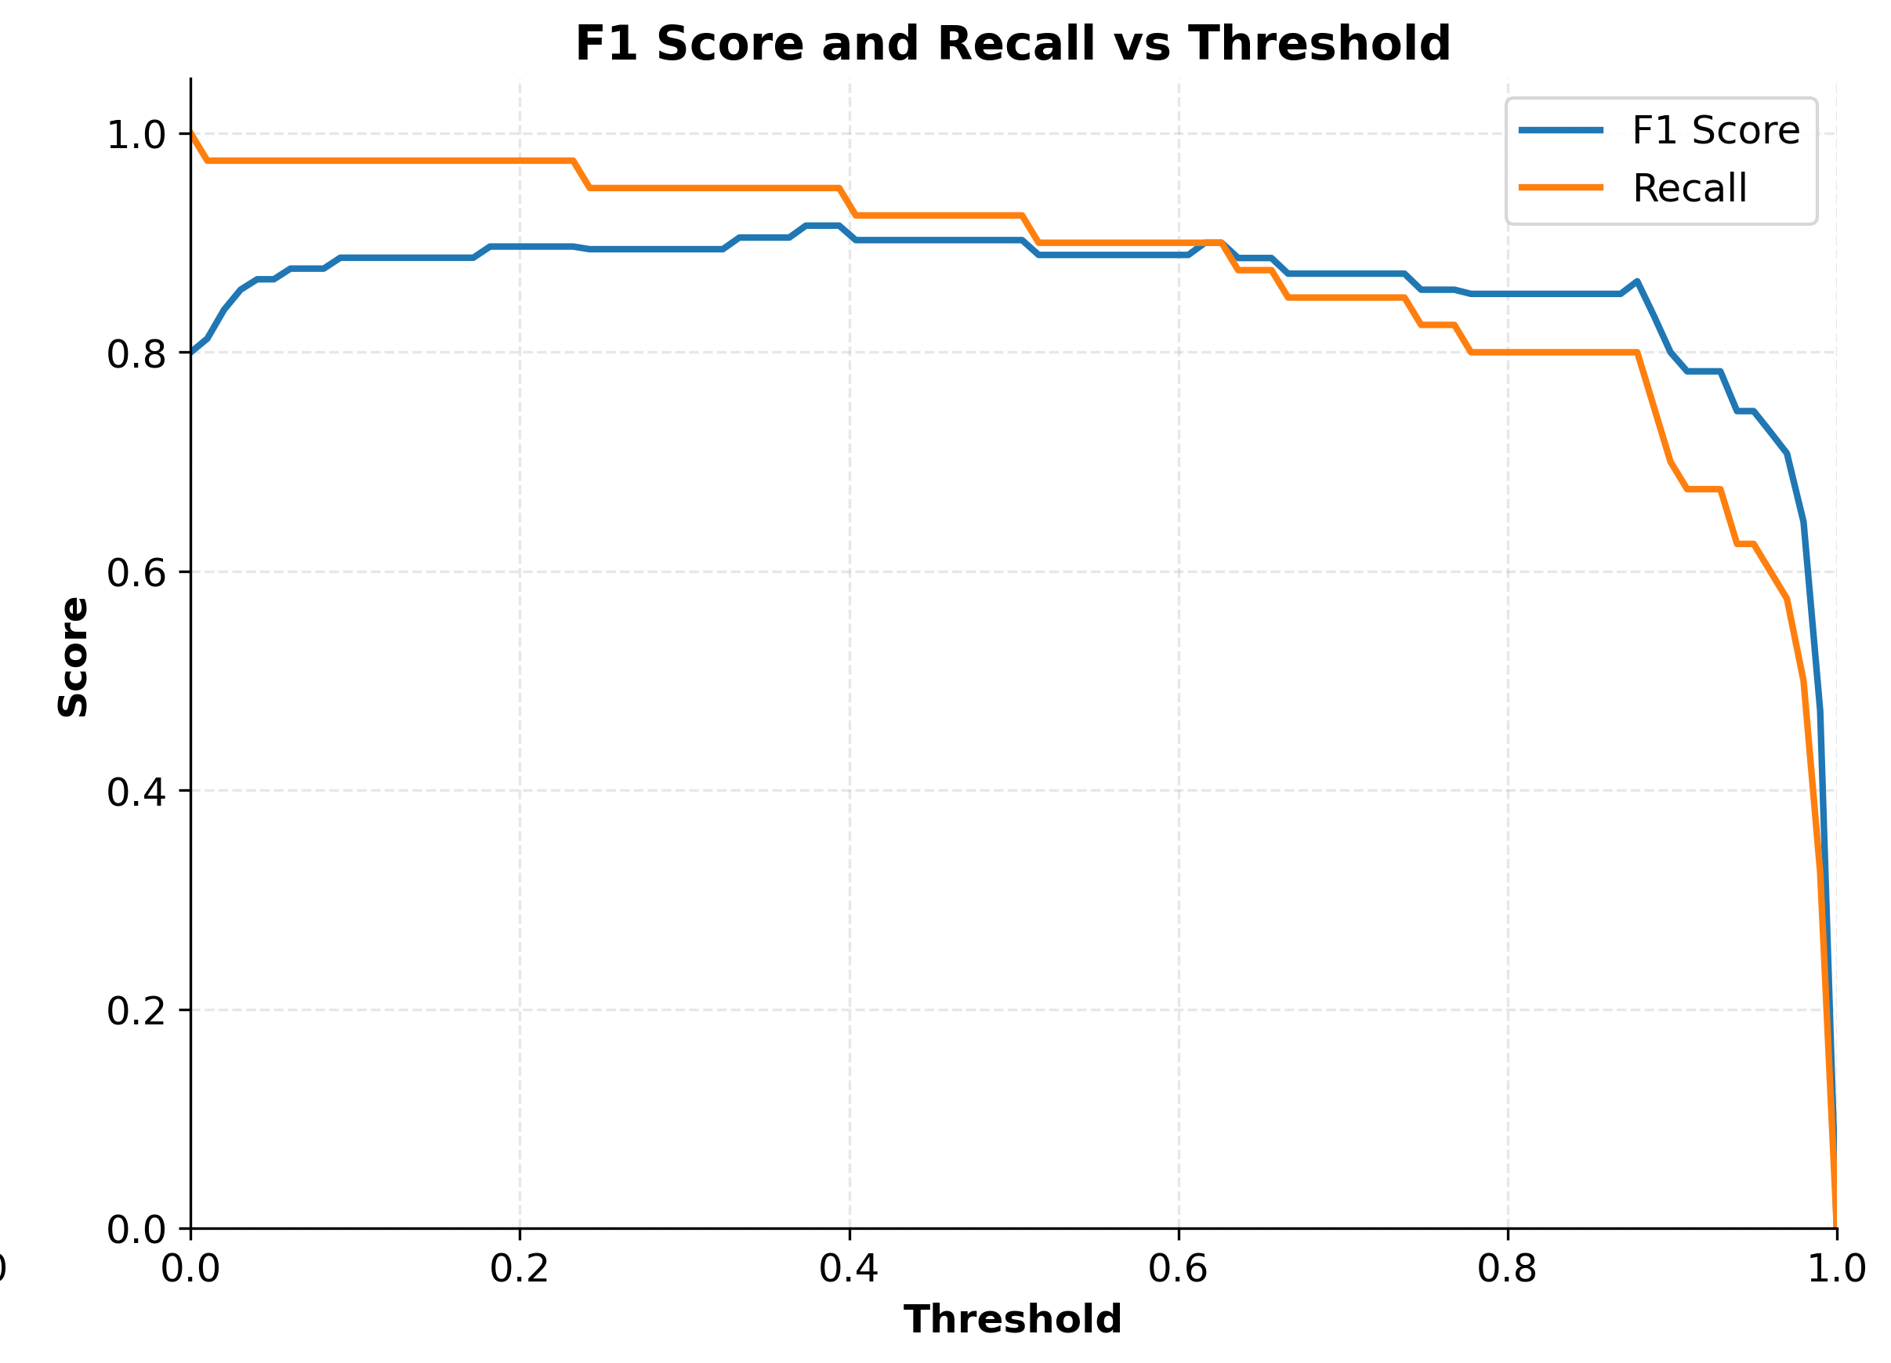
Early Cancer Detection Using Multi-Scale CNN and Transformer-Based Deep Learning Approaches
Chengdu University of Technology, CDUT Sino-British Collaborative Education
Xinyu Luo(Carson) | 202118020329 | Supervisor: Dr. Grace U. Nneji
Abstract
This study proposes a hybrid deep learning framework for early breast cancer detection based on histopathological image analysis. The model integrates Convolutional Neural Networks (CNNs) and Vision Transformers (ViTs), leveraging EfficientNetV2 for efficient local feature extraction and ViTs enhanced with Shifted Patch Tokenization (SPT) for global context modeling. The framework was trained and evaluated on the BreakHis dataset comprising over 7,900 images at multiple magnification levels, and further validated on the BACH dataset of 400 high-resolution microscopy images. On the BreakHis dataset, the model achieved a test accuracy of 92.1%, an AUC-ROC of 0.9715, and a sensitivity of 94.6%, while on the BACH dataset, it attained an accuracy of 86.7%, AUC-ROC of 0.8700, and sensitivity of 92.5%. These results demonstrate the model’s strong classification performance and generalization capability across different datasets. The proposed approach shows considerable potential for clinical applications that require reliable, high-sensitivity diagnostic support in digital pathology.
Dataset 1: BreakHis
Methodology
1,995 benign, 2,081 malignant images
70/10/20 split (train/val/test) with class balancing via random oversampling
Dataset 2：BACH
100 benign, 200 malignant (after re-labeling)
80/20 split with oversampling to balance classes
Split Strategy
Custom stratified split:
BreakHis: 70% train, 10% val, 20% test
BACH: 80% train, 20% test
Preprocessing
Resize all images to 160×160
Normalize to [0,1]
Apply real-time data augmentation:
Random rotation (±90°), zoom (0.8–1.2×), translation, horizontal/vertical flip
This study proposes a hybrid deep learning model combining Convolutional Neural Networks (CNNs) and Vision Transformers (ViTs) to classify histopathological images of breast cancer. The model is trained on the BreakHis dataset (100x magnification), using a dual-branch architecture: The EfficientNetV2 [1] branch extracts local features through compound convolutional scaling.
The ViT branch utilizes Shifted Patch Tokenization (SPT) [2] to enhance local spatial representation and Learned-Scale Attention (LSA) to adjust attention scores adaptively.
Figure 1: Shifted Patch Tokenization generates 5 shifted views to improve spatial diversity
Figure 2: Learned-Scale Attention dynamically adjusts attention scores across heads.
Figure 3: Hybrid architecture combining EfficientNetV2 and ViT for breast cancer classification.
BreakHis Dataset
Results
train_acc=0.9317
val_acc=0.9095
train_loss=0.8145
val_loss=0.8934
TN=107, TP=265, FP=18, FN=15
AUC=0.971
BACH Dataset
Figure 4: Training Resulets Summary of BreakHis Dataset
train_acc=0.9219
val_acc= 0.8667
train_loss=0.3256
val_loss=0.6208
TN=15, TP=37, FP=5, FN=3
AUC=0.870
Conclusion
Figure 5: Training Resulets Summary of BACH Dataset
Future Work
Developed a hybrid EfficientNetV2 + ViT model for breast cancer detection
Enhanced spatial and contextual learning via SPT + LSA
Achieved high sensitivity in detecting malignant histopathological patterns
Demonstrated interpretable predictions via Grad-CAM heatmaps
Limitation
Relies solely on histopathological images (single modality)
Computationally heavy ViT may hinder deployment in low-resource settings
Grad-CAM provides basic interpretability, but lacks uncertainty-aware insights
Extend to 8-class classification by merging BreakHis & BACH full datasets
Incorporate clinical metadata and other modalities (e.g., radiology, genomics)
Explore lighter ViT variants (e.g., MobileViT, Swin) for real-time deployment
Enhance interpretability with attention trajectory maps or uncertainty visualization
Reference
[1] M. Tan and Q. V. Le, ‘EfficientNetV2: Smaller Models and Faster Training’, 2021, doi: 10.48550/ARXIV.2104.00298.
[2] S. H. Lee, S. Lee, and B. C. Song, ‘Vision Transformer for Small-Size Datasets’, 2021, arXiv. doi: 10.48550/ARXIV.2112.13492.

